Slide 1
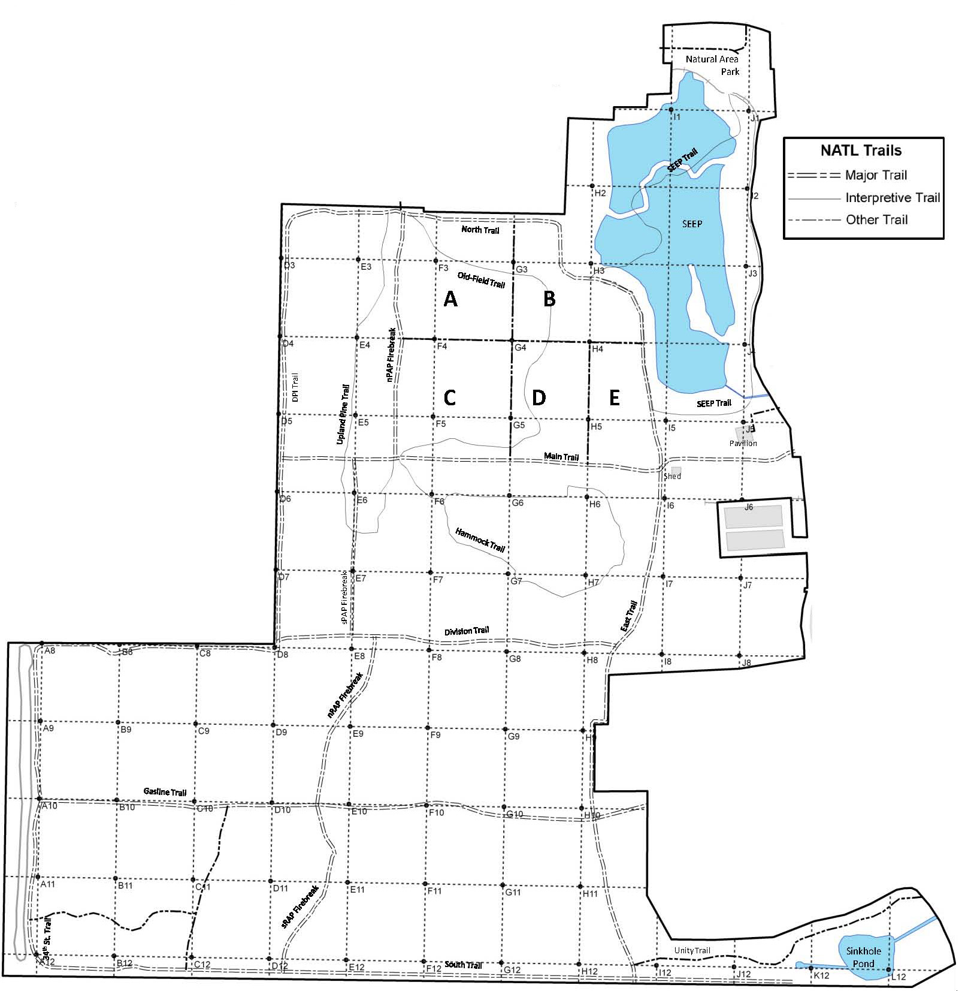
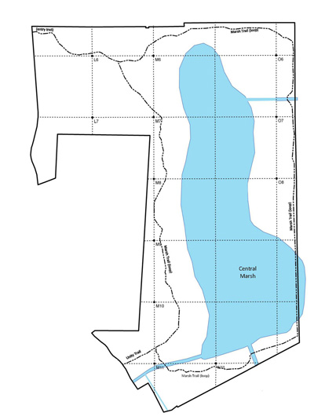
Cat’s Claw (Macfadyena unguis-cati)
Potential threat for NATL: □ Major □ Moderate □ Minor □ Uncertain Current status in NATL: □ Eradicated □ Controlled □ Diminished □ Threatening
Current management: □ Routine monitoring □ Controlled when found by:
□ Manual removal □ Herbicide applied to: foliage stem or stump soil
Legend Legacy site Old active site New active site Extent of infestation
NATL-west
NATL-east
□ No sites in NATL-east □ See larger map for details
Definitions
Legacy site. Site found and declared
cleared prior to 2009.
Old active site. Regularly monitored site
known prior to May 2011
when Ethan Carter took
charge of invasives.
New active site. Regularly monitored site
discovered by Ethan
Carter.

