Slide 1
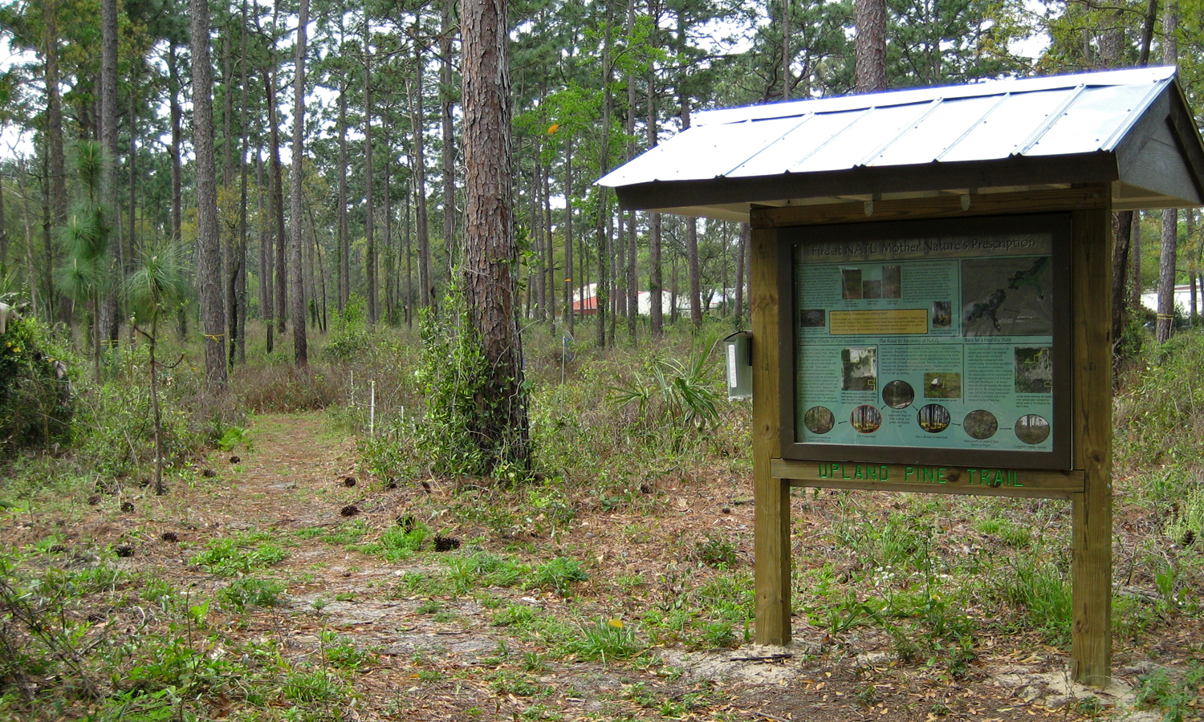
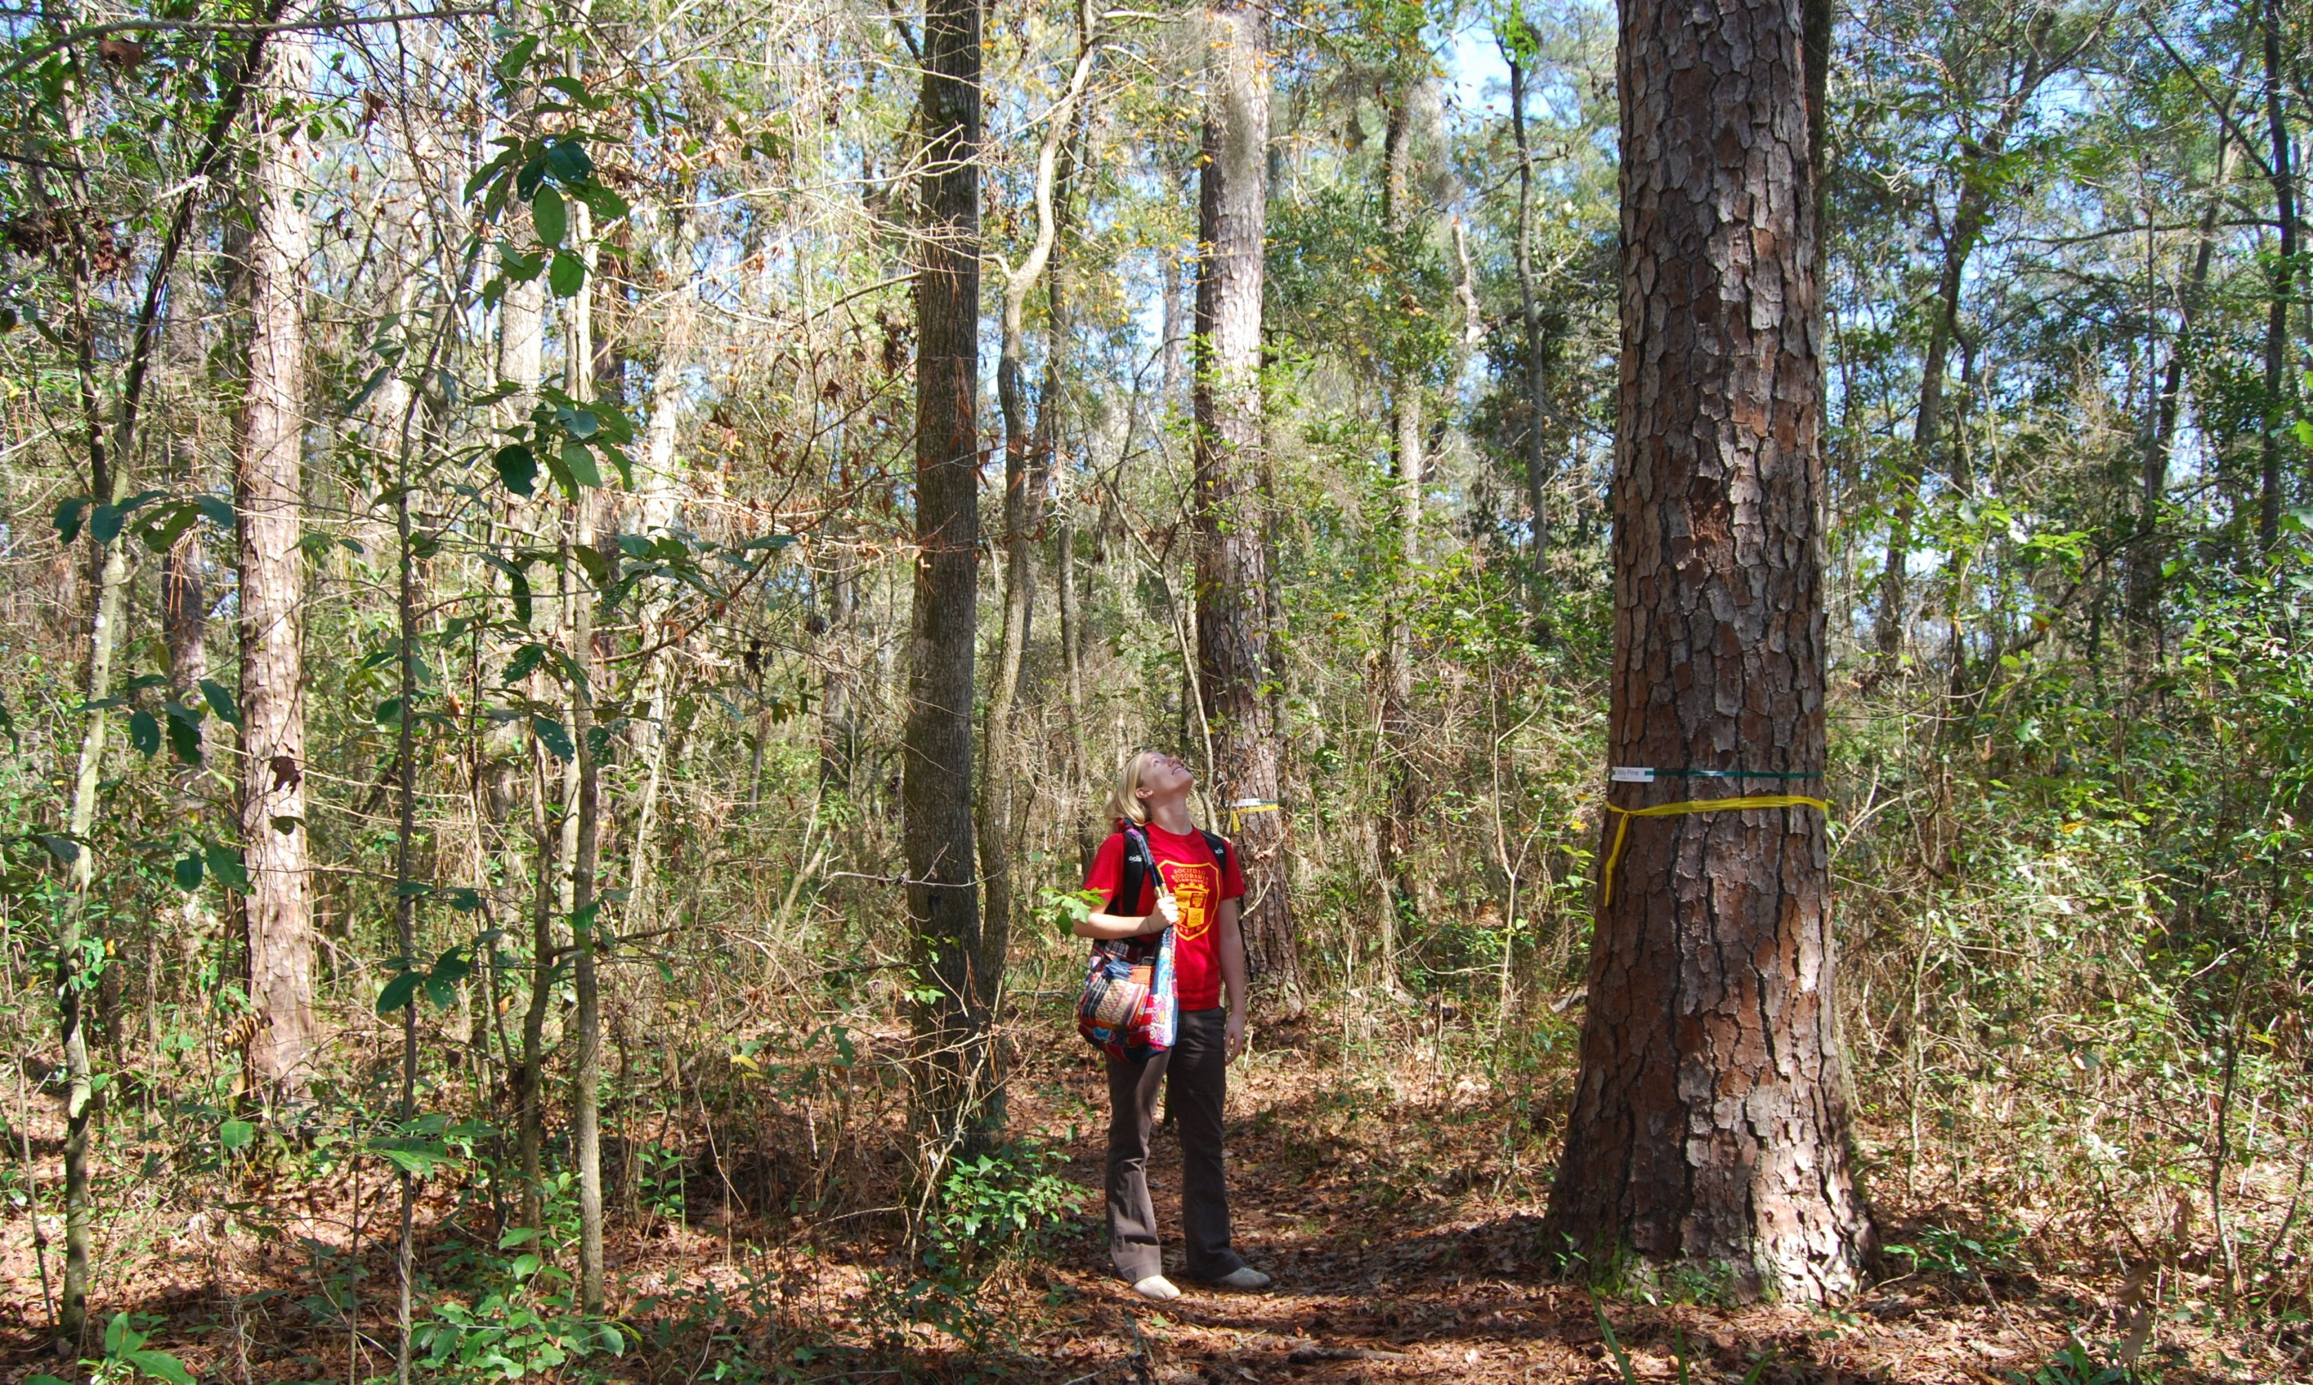
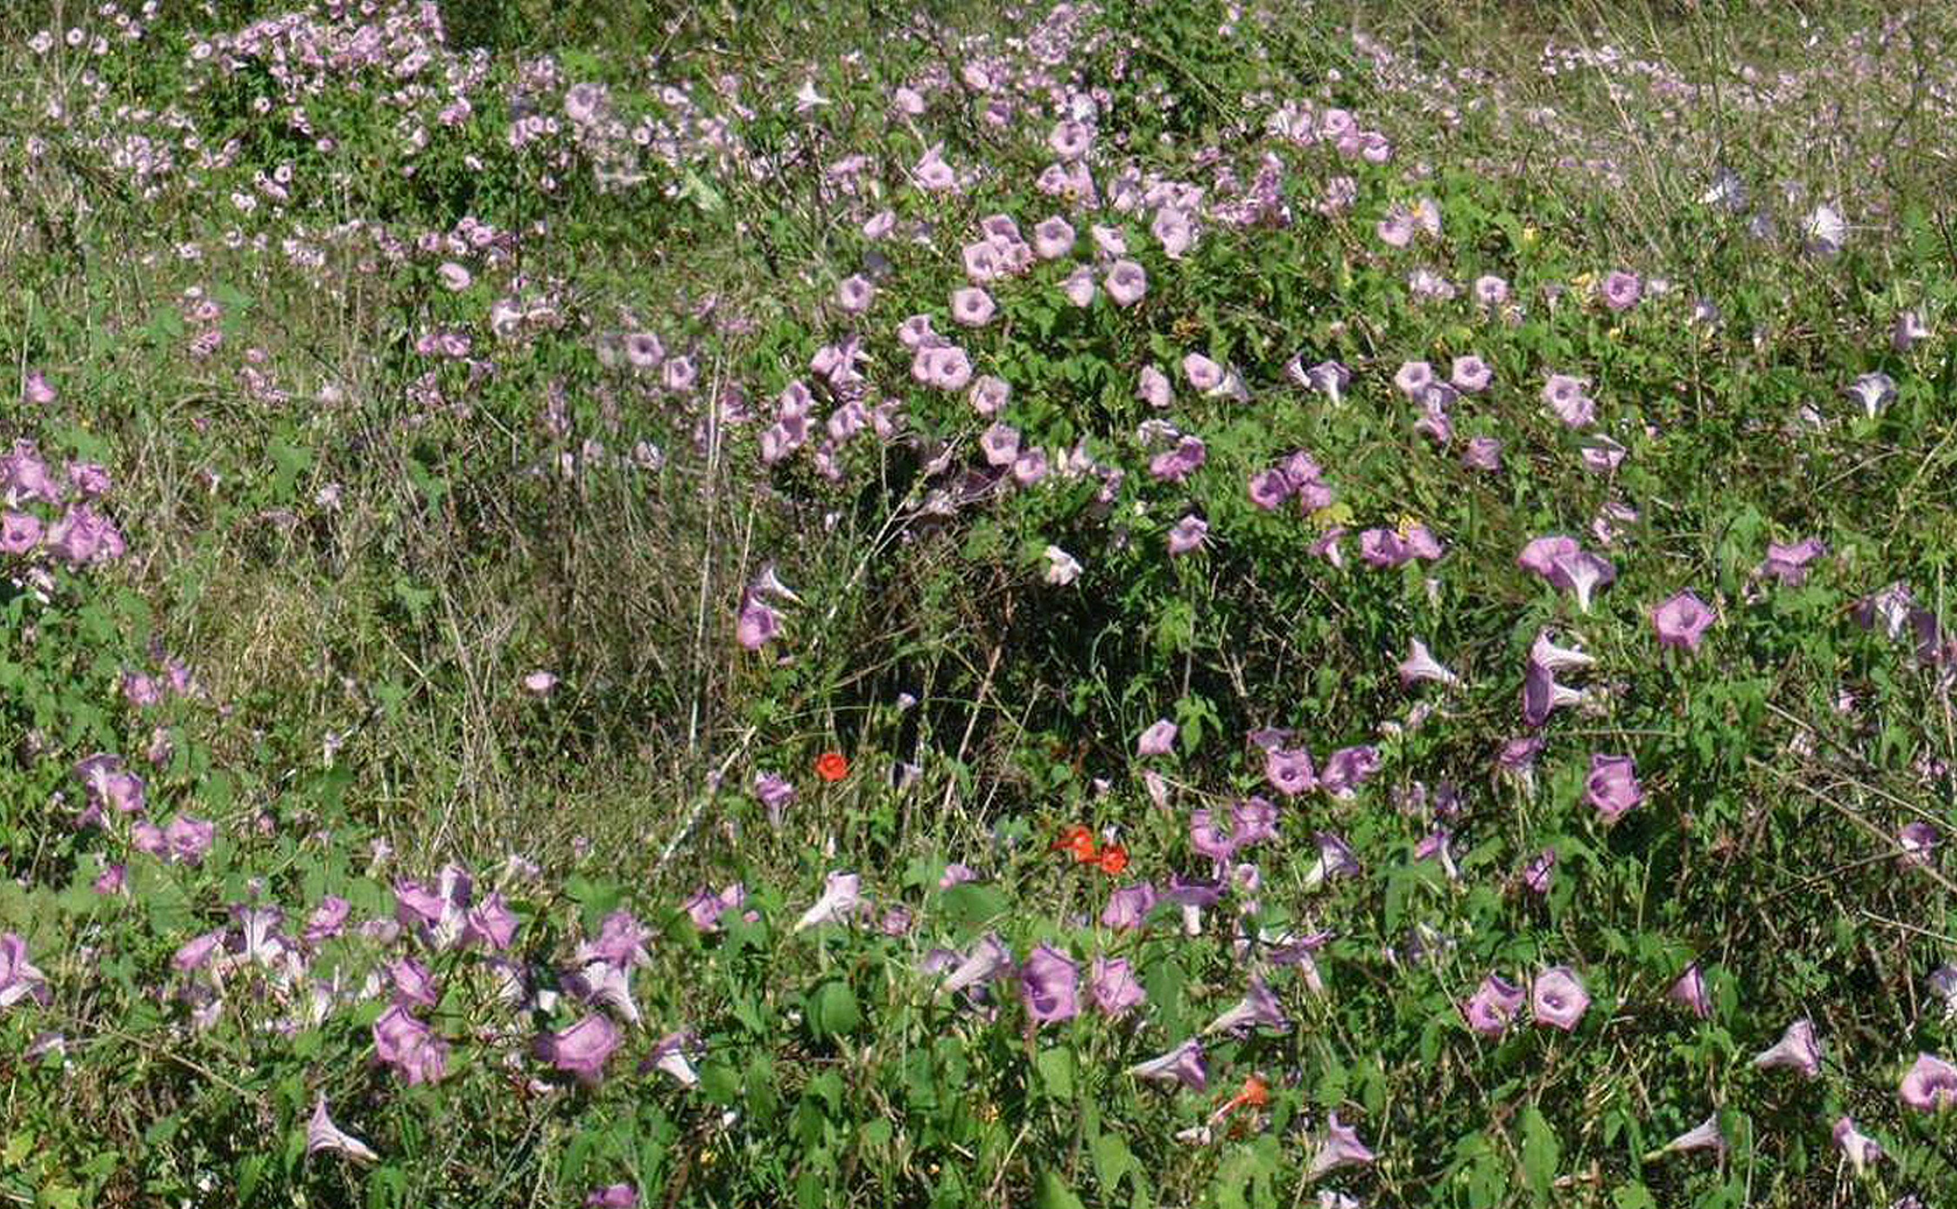
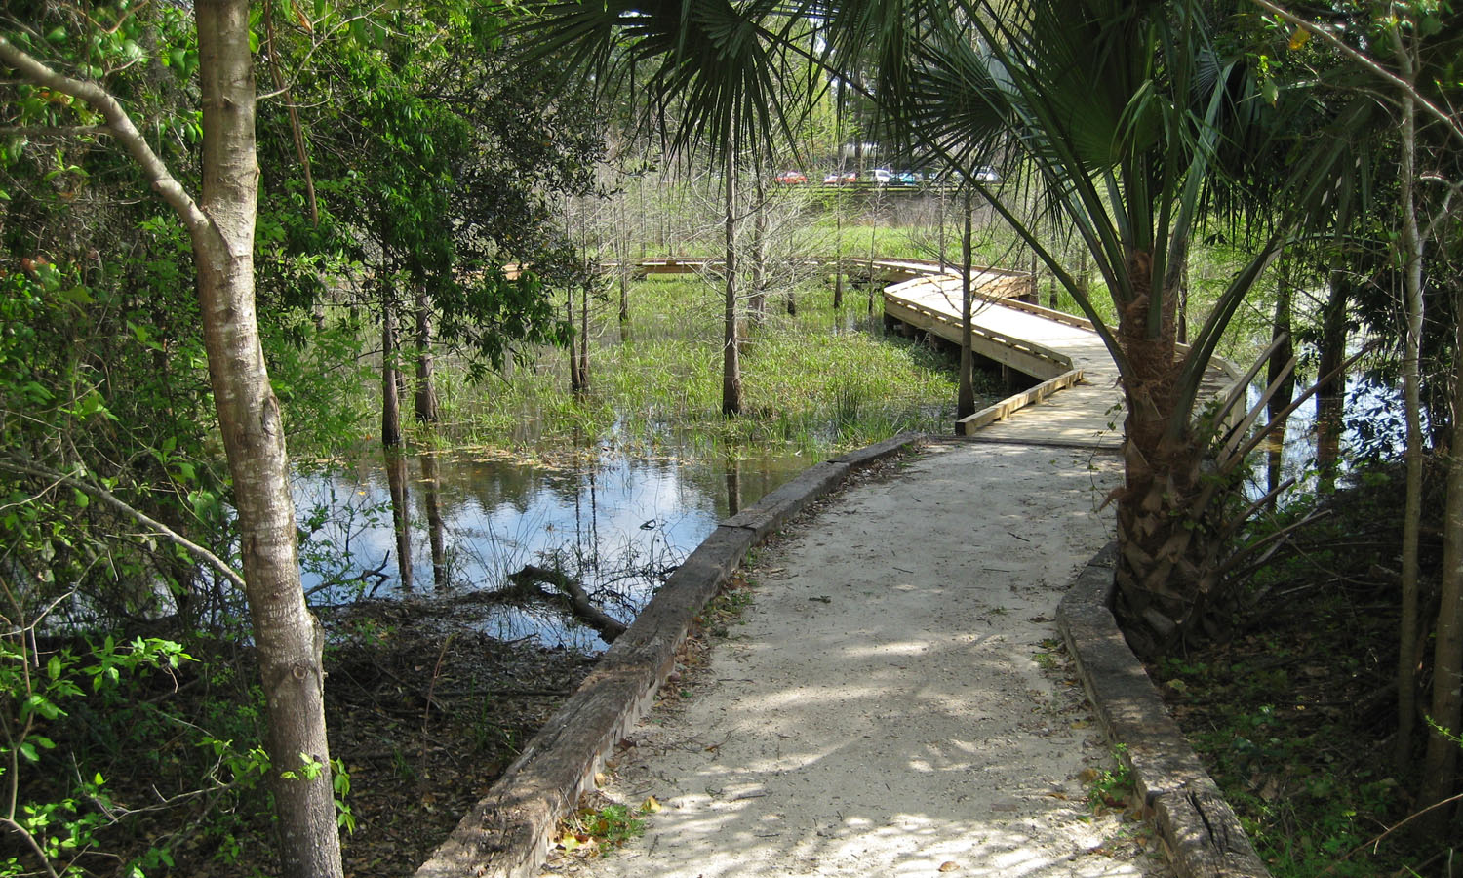
Four Florida Ecosystems for You to Explore!
Nature Trails of UF’s Natural Area Teaching Laboratory (NATL)
Upland Pine Trail
(1/4 mi.) - 200 ft. to trailhead
Hammock Trail
(1/4 mi.) - Begins where Upland Pine and Old Field Trails end
Old Field Trail
(1/4 mi.) - 200 ft. to trailhead
SEEP Trail (wetlands)
(3/4 mi.) - Follow signs or start at Natural Area Park

