Slide 1
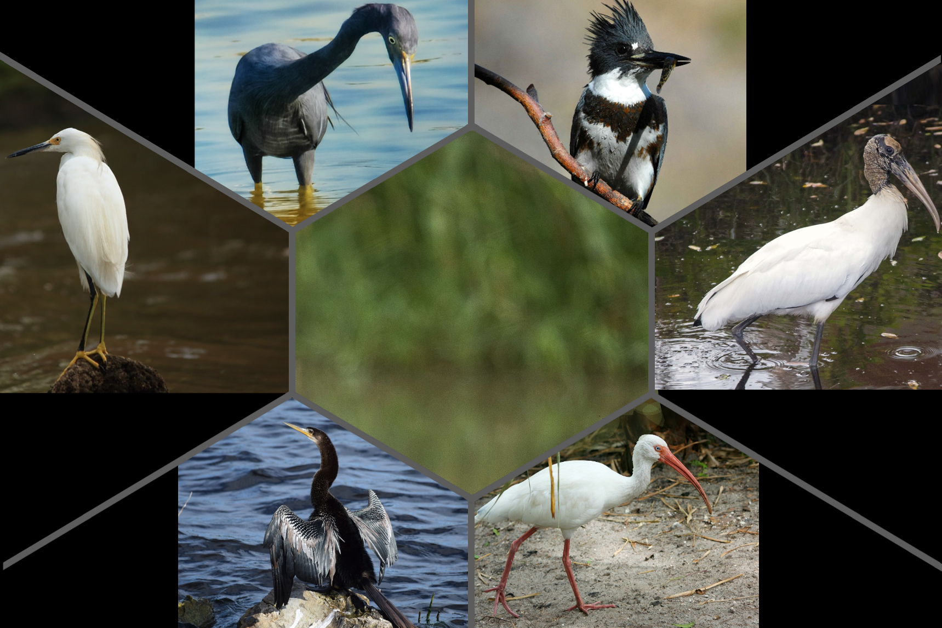
Stands and waits for prey in shallow water
Photo shows adult; juveniles are white
Mostly solitary, rests and roosts in mixed colonies
Little Blue Heron
Egretta caerulea
Belted Kingfisher
Megaceryle alcyon
Perches along pond edges, hovers above water, pierces fish with thick bill
Photo shows adult male; females have two bands across chest
Solitary unless breeding, pairs nest in burrows
Fun Fact: The Little Blue Heron is the only heron that looks completely different as a juvenile versus as an adult.
Fun Fact: To avoid being eaten by hawks, they will dive into the water.
BIRDS of the SEEP
Snowy Egret
Egretta thula
What are Wetland Birds?
These are birds that rely on wetland habitats for feeding and breeding. They are also important indicators for the health of wetlands they inhabit.
Why is NATL habitat beneficial for these birds?
NATL provides wading birds with wetland foraging habitat, water, and shelter.
What do wading birds do for NATL?
The wading birds of the SEEP play
significant roles in the environment. By
consuming small fish, aquatic insects, and
amphibians, they help regulate the food web.
This prevents overpopulation of smaller wildlife
and ensures a balanced ecosystem.
Fun Fact: The Snowy Egret was hunted almost to extinction in the early 1900s for its beautiful feathers which were used to make ladies’ hats.
Wood Stork
Mycteria americana
Stirs up water with feet, chases prey with outstretched wings, and stalks along edge of water
The bill will turn green in the breeding season
Solitary, will nest in groups
Walks with its head down and curved beak open
Photo shows adult; juveniles have a pale bill and grayish feathers on the neck
Forages in groups and forms pair bonds
Fun Fact: The Wood Stork is the only stork that breeds in the United States.
Anhinga
Anhinga anhinga
Fun Fact: It has a long tail that accounts for its nickname the “water turkey.”
Fun Fact: The White Ibis is the mascot of the Miami Hurricanes due to the bird’s reputation as the last to leave a hurricane but the first to return.
Swims and dives to catch prey with dagger-like bill
Photo shows male; females will have a pale head, neck, and breast with a dark belly
Solitary, aggressive towards others
Sifts water and probes the ground for prey using long, curved beak
Photo shows adult; juveniles have dark plumage
They nest and forage in large groups
White Ibis
Eudocimus albus

