Slide 1
Native Bee Nesting Habitat
Jason R. Graham
University of Florida
PhD Dissertation Project

Slide 2
Pollination is an important natural ecosystem service supporting a large portion of managed agriculture and natural plant communities. Our fruit, vegetable and seed crops are directly dependent on animal mediated pollination as are many crops providing our medicines, fibers, fuels and livestock forage crops. Pollination benefits flowering plants by carrying pollen between the male and female parts of flowers.
Bees (and some wasps) are specialized pollinators in that they require pollen as a source of food particularly during the larval growth phase. Bees are attracted to flowers for nectar, pollen and essential oils and as they forage for these necessities they inadvertently transfer pollen from plant to plant increasing the fruit and seed set as well as the genetic diversity of the plants they visit.

Slide 3
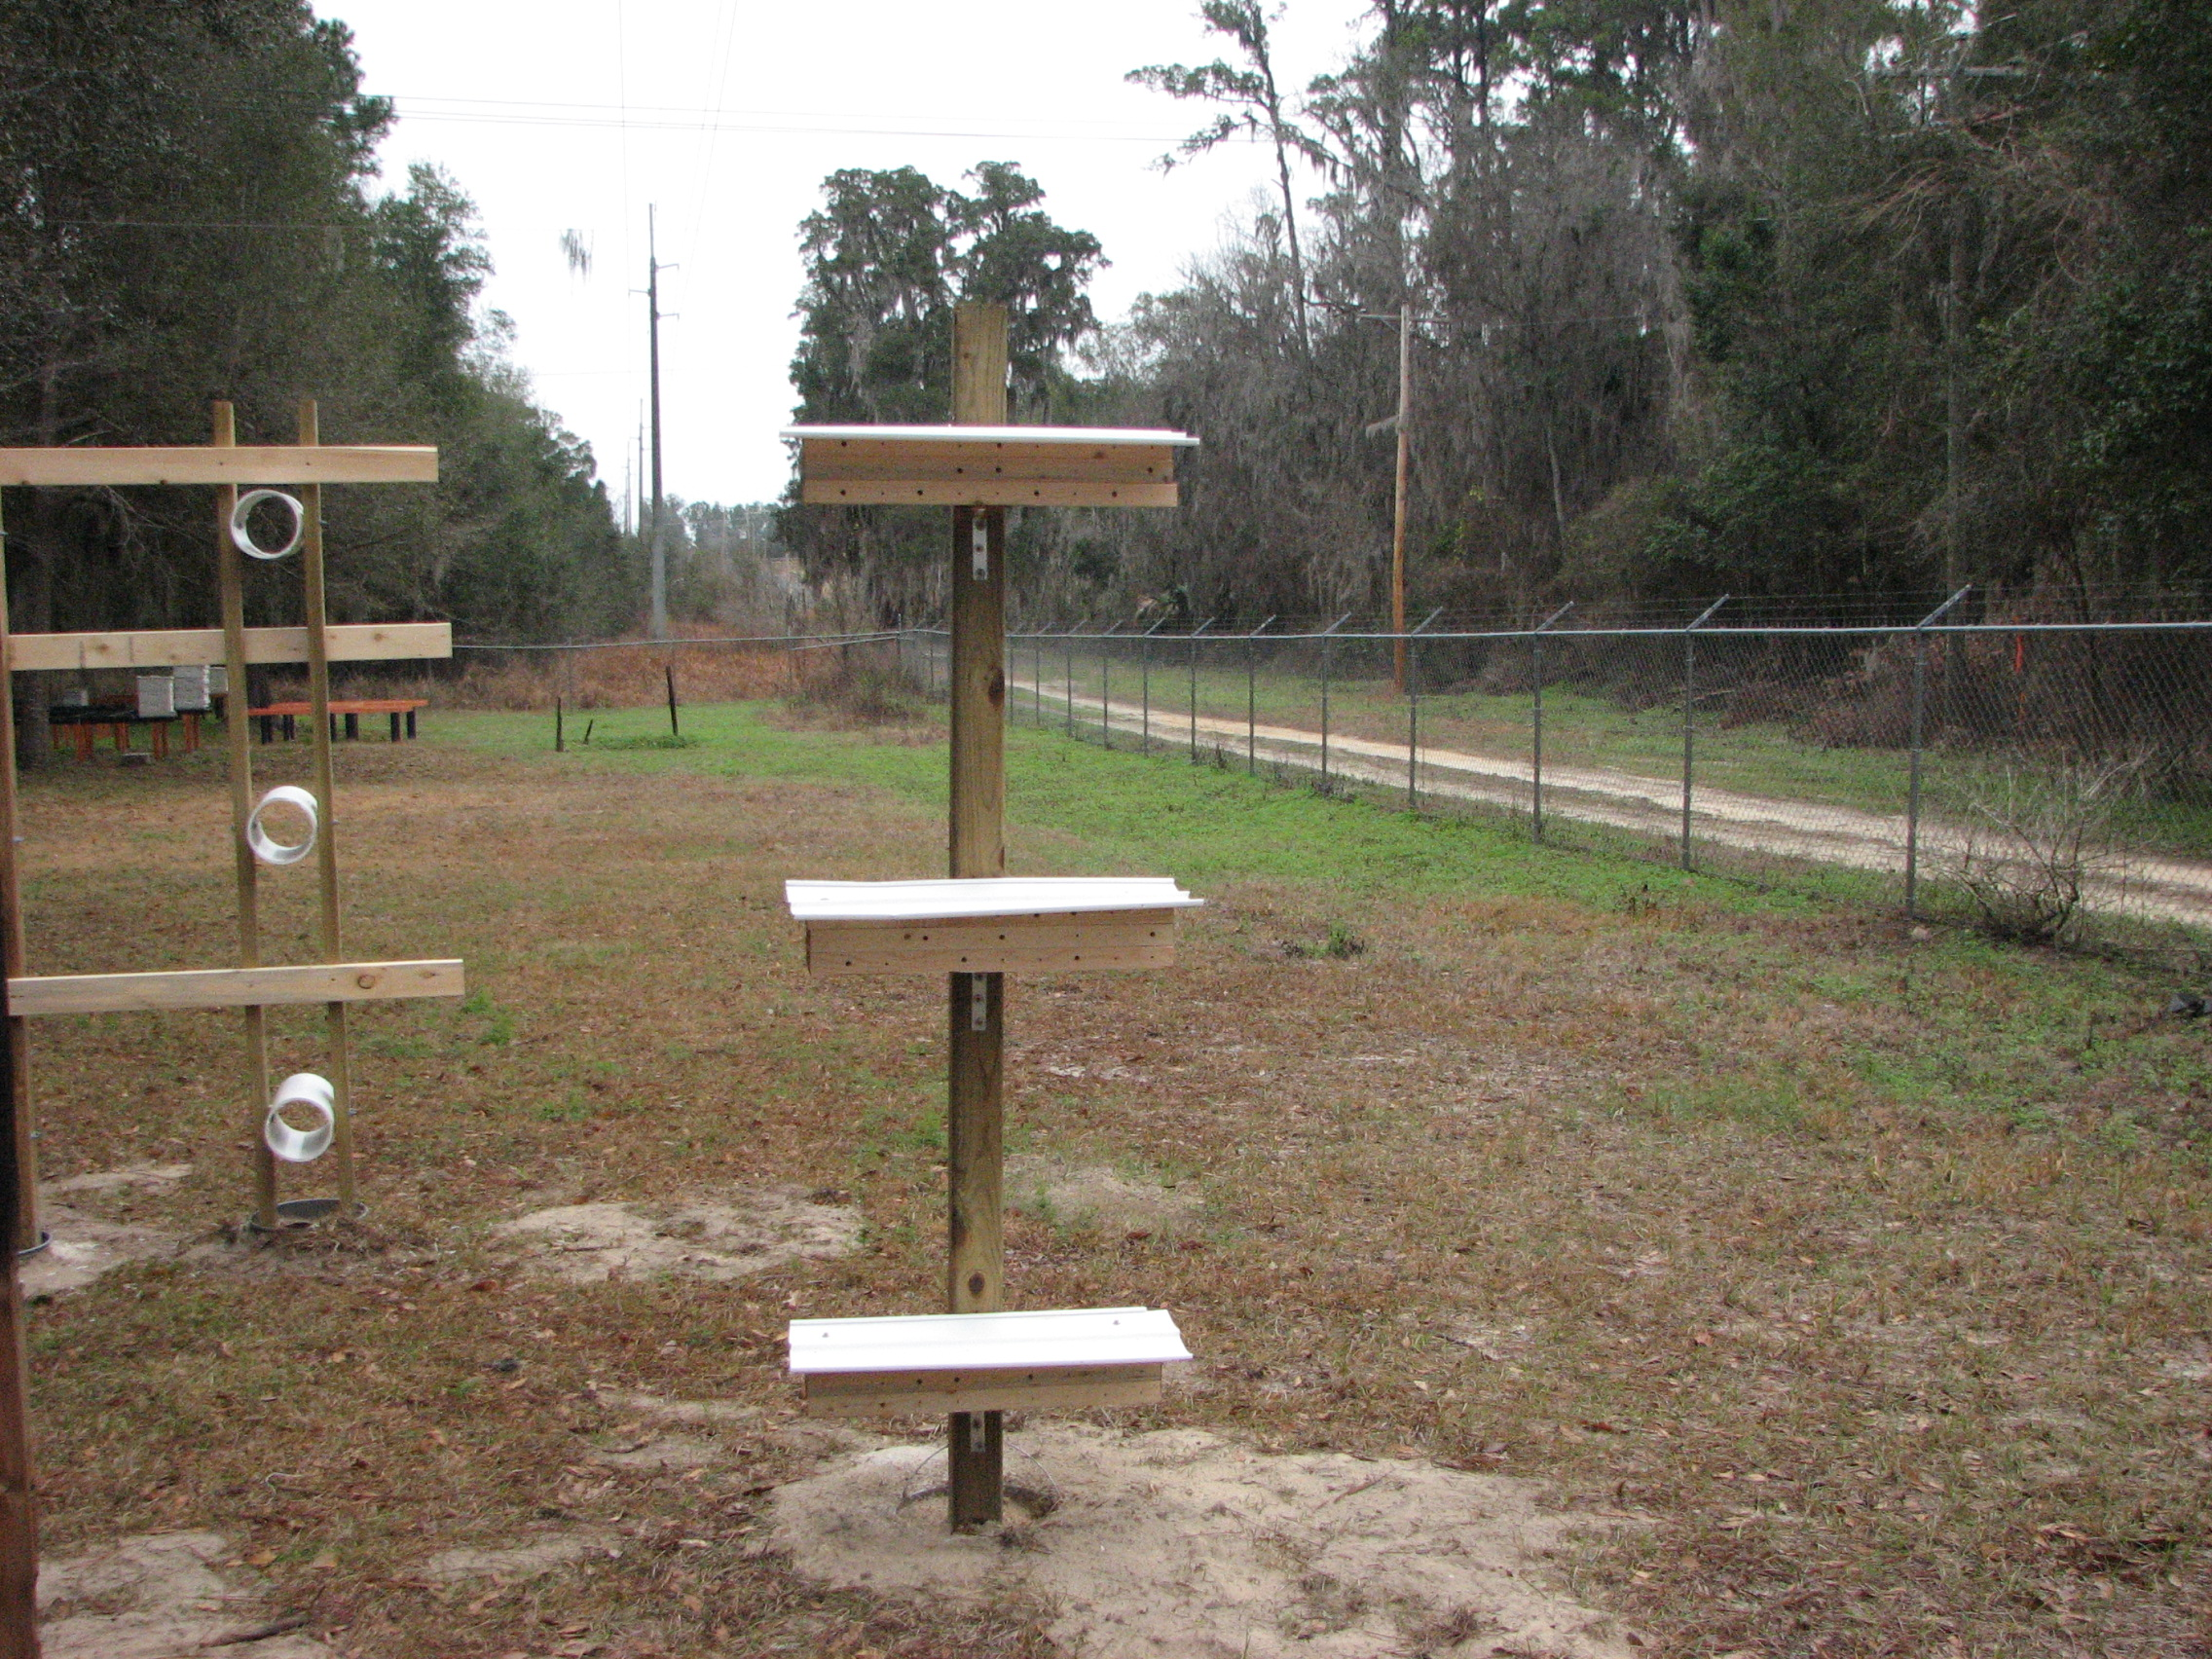
Bee Blocks
Testing preference of hole diameter and height of bee block.

Slide 4
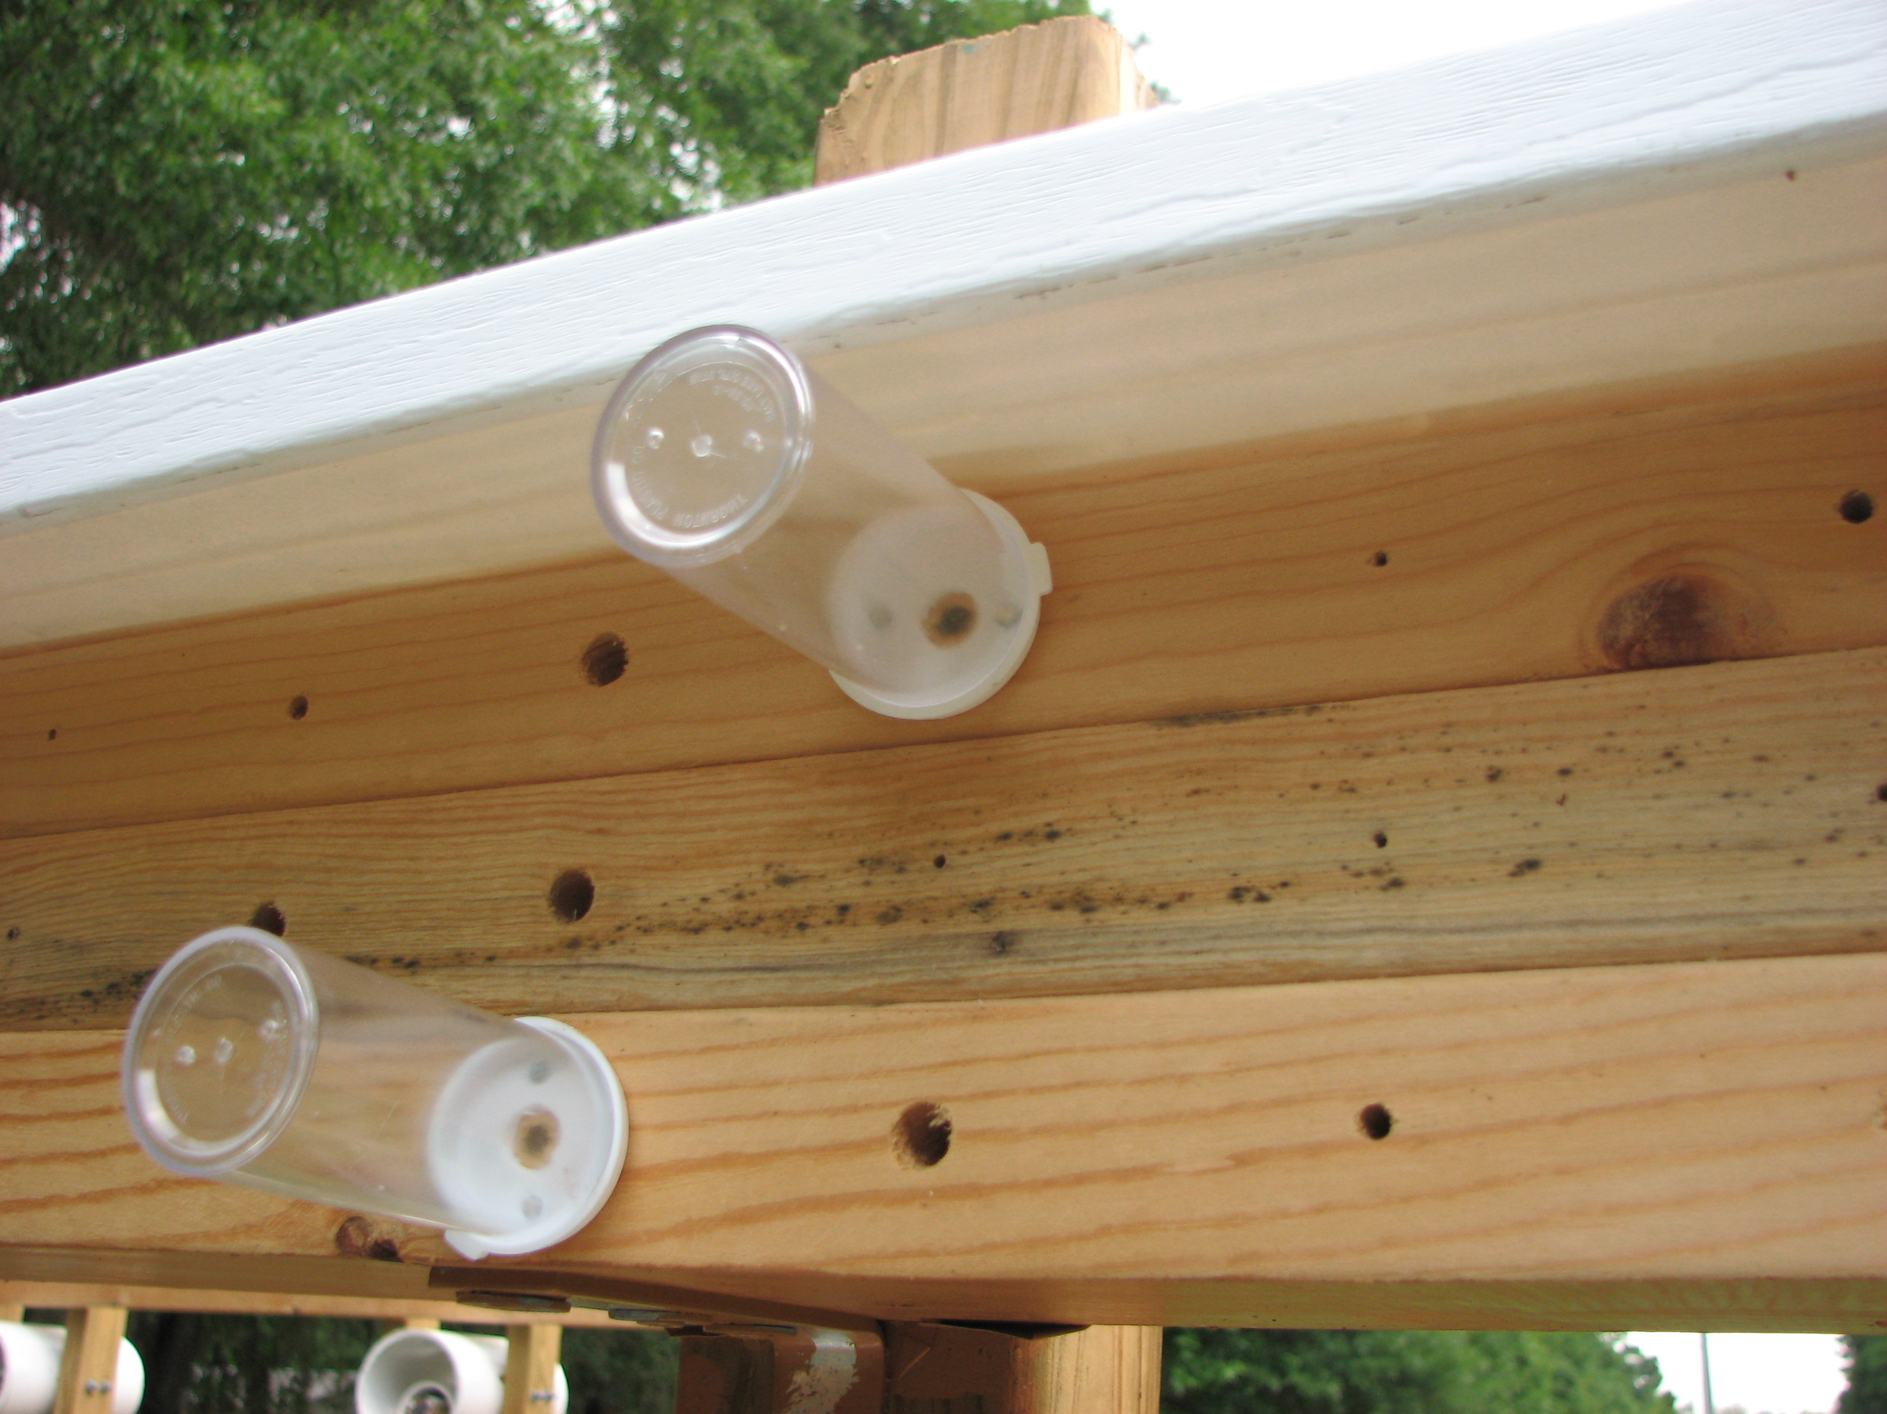
We capture a sample as the adult bees emerge to learn more about the local bees that are using the nesting sites.

Slide 5
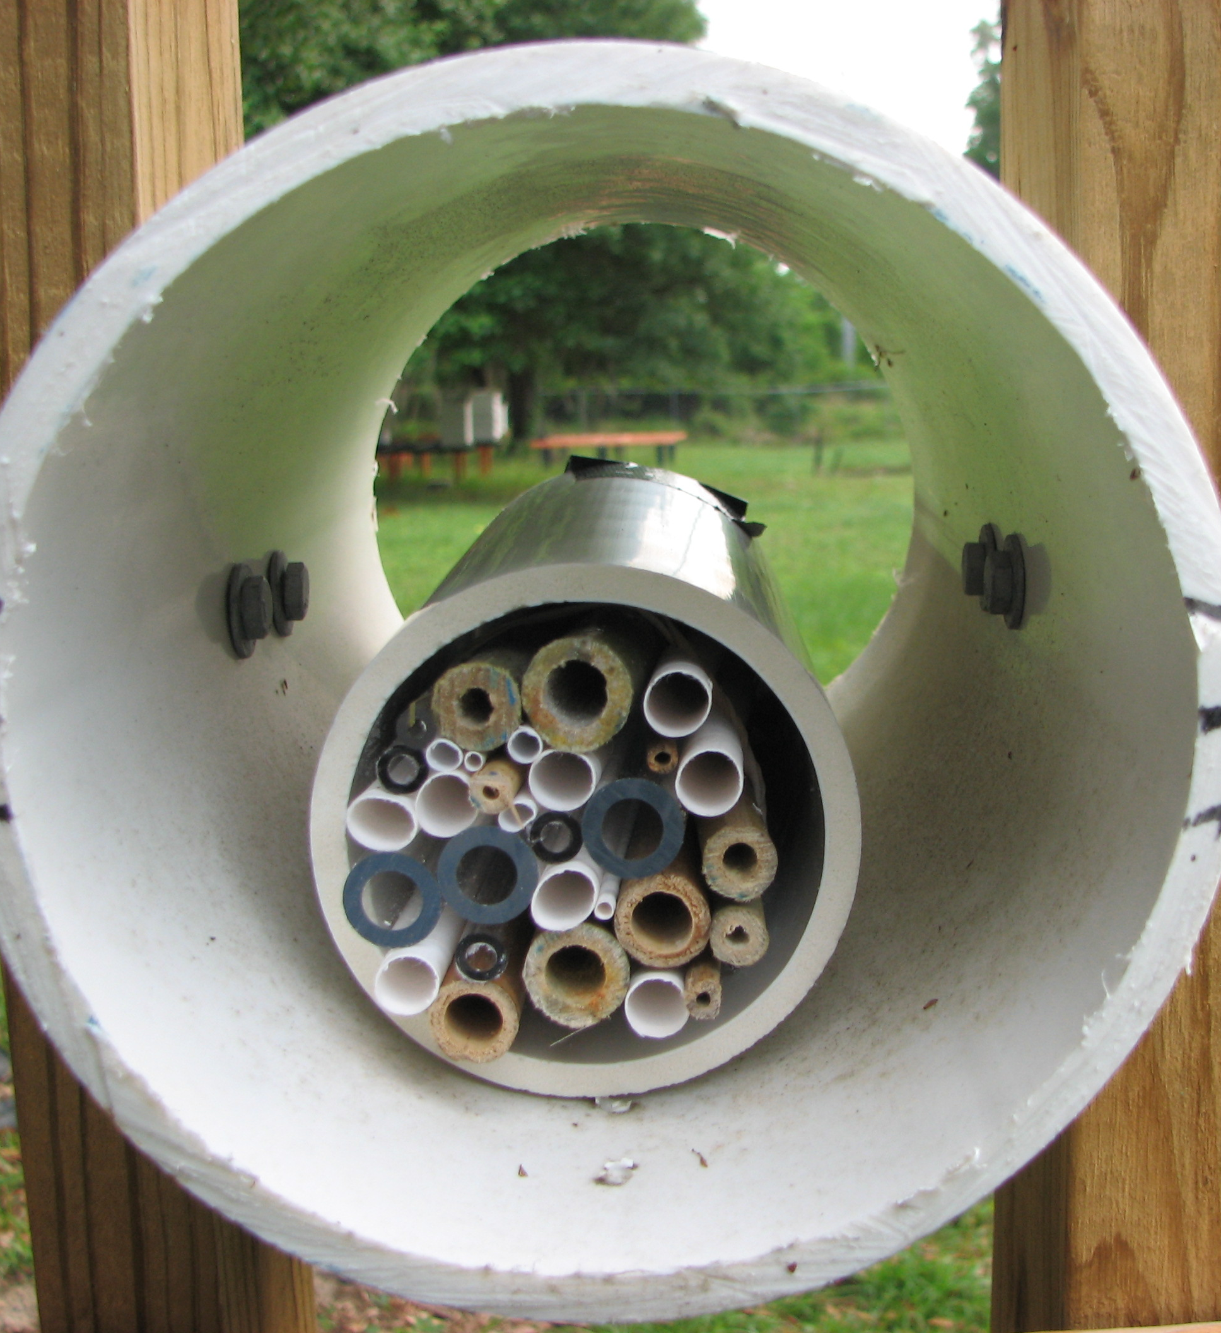
Bee Straws
Testing preference of material, diameter and height of straw holder.

Slide 6
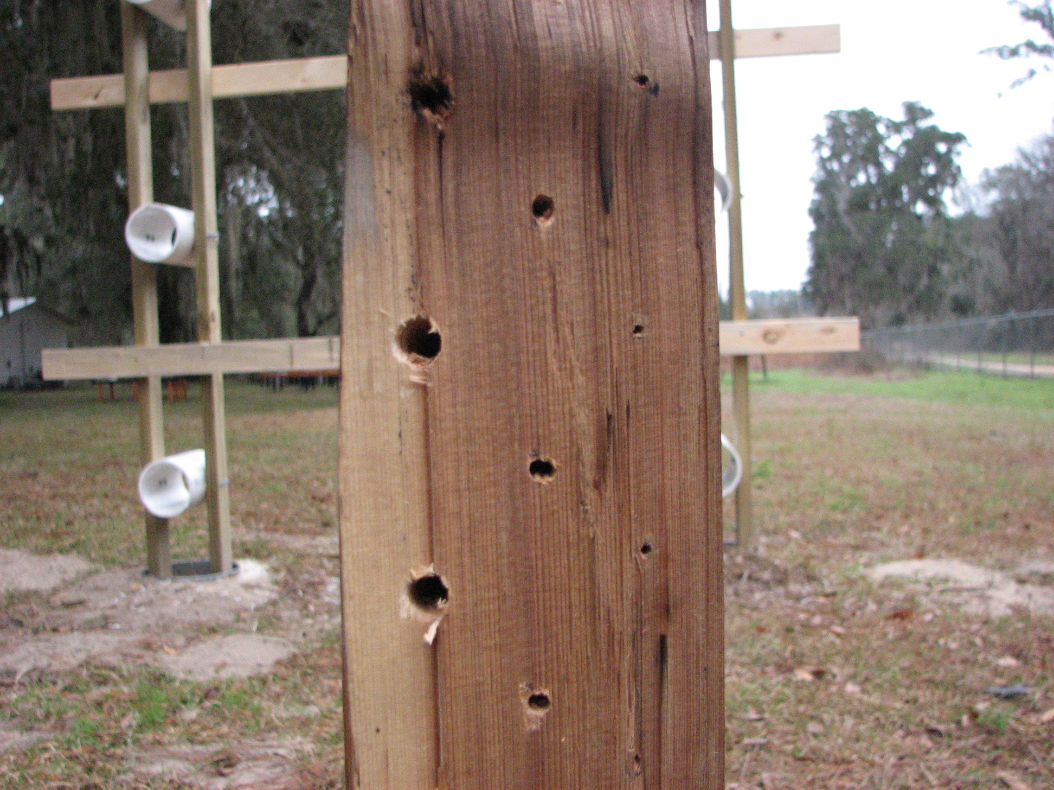
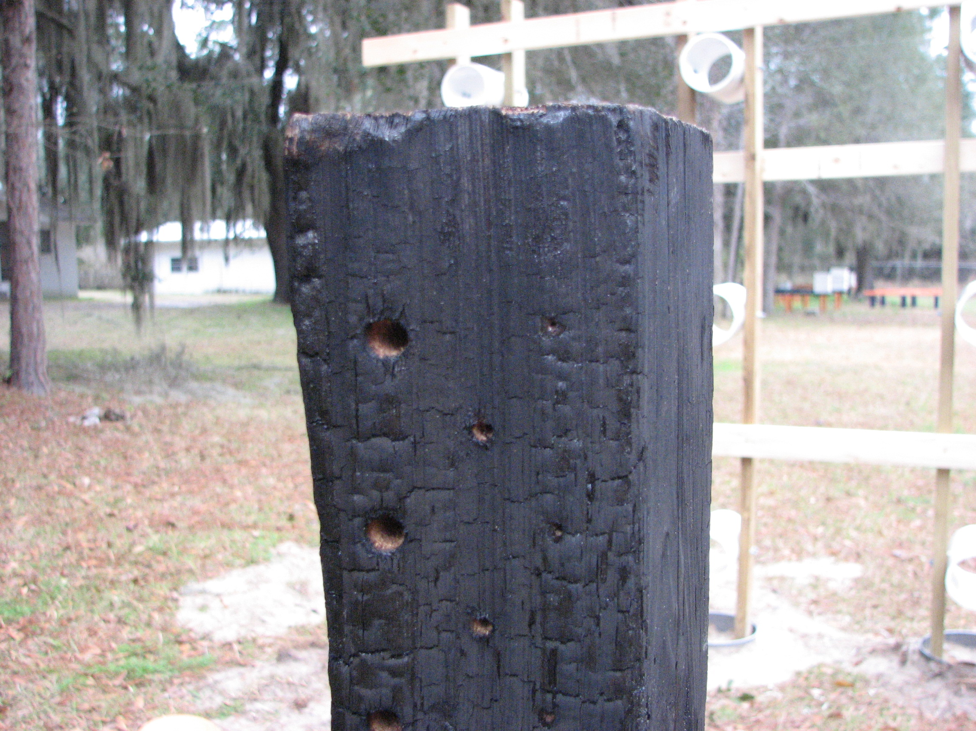
Fire Ecology
Testing preference of charred vs. not charred natural cedar wood and inside diameter of holes.

Slide 7
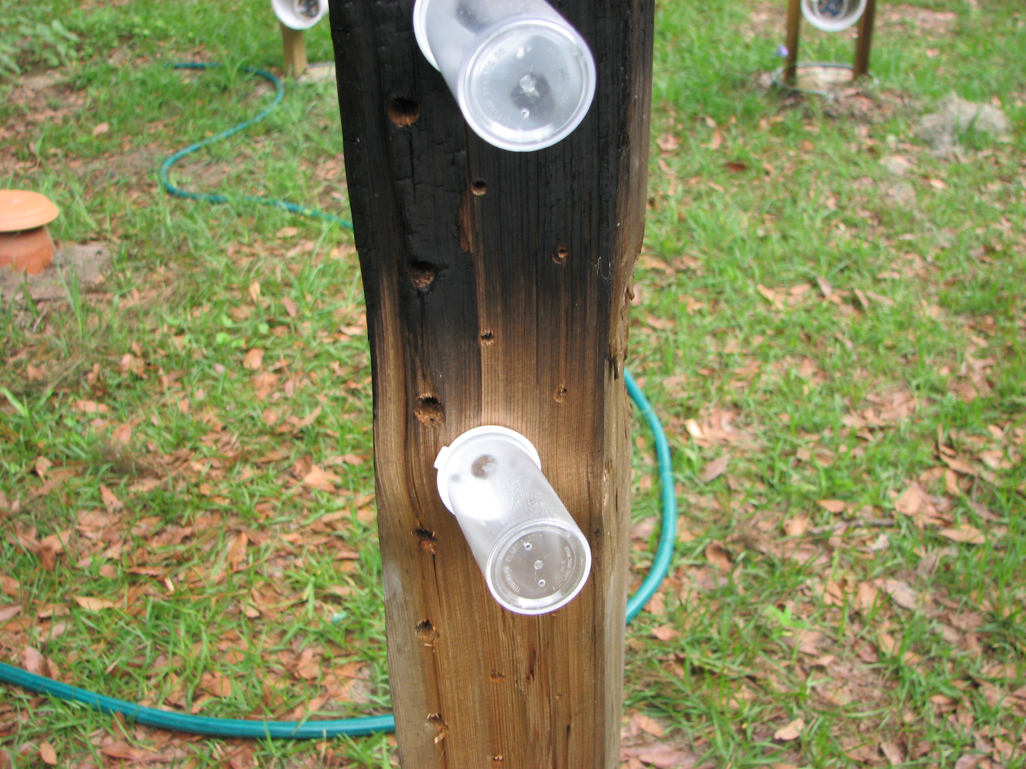

Slide 8
Sites
UF Bee Biology Unit, Gainesville
Kanapaha Botanical Gardens, Gainesville
Ellis Estates, High Springs
Plant Science Research and Education Unit, Citra
Straughn Blueberry Farm, Windsor
Morningside Nature Center, Gainesville
Santa Fe Teaching Zoo, Gainesville
UF Natural Teaching Laboratory, Gainesville
Wood-Sparling Estates, Gainesville
Gum Root Park, Gainesville

Slide 9
