Slide 1
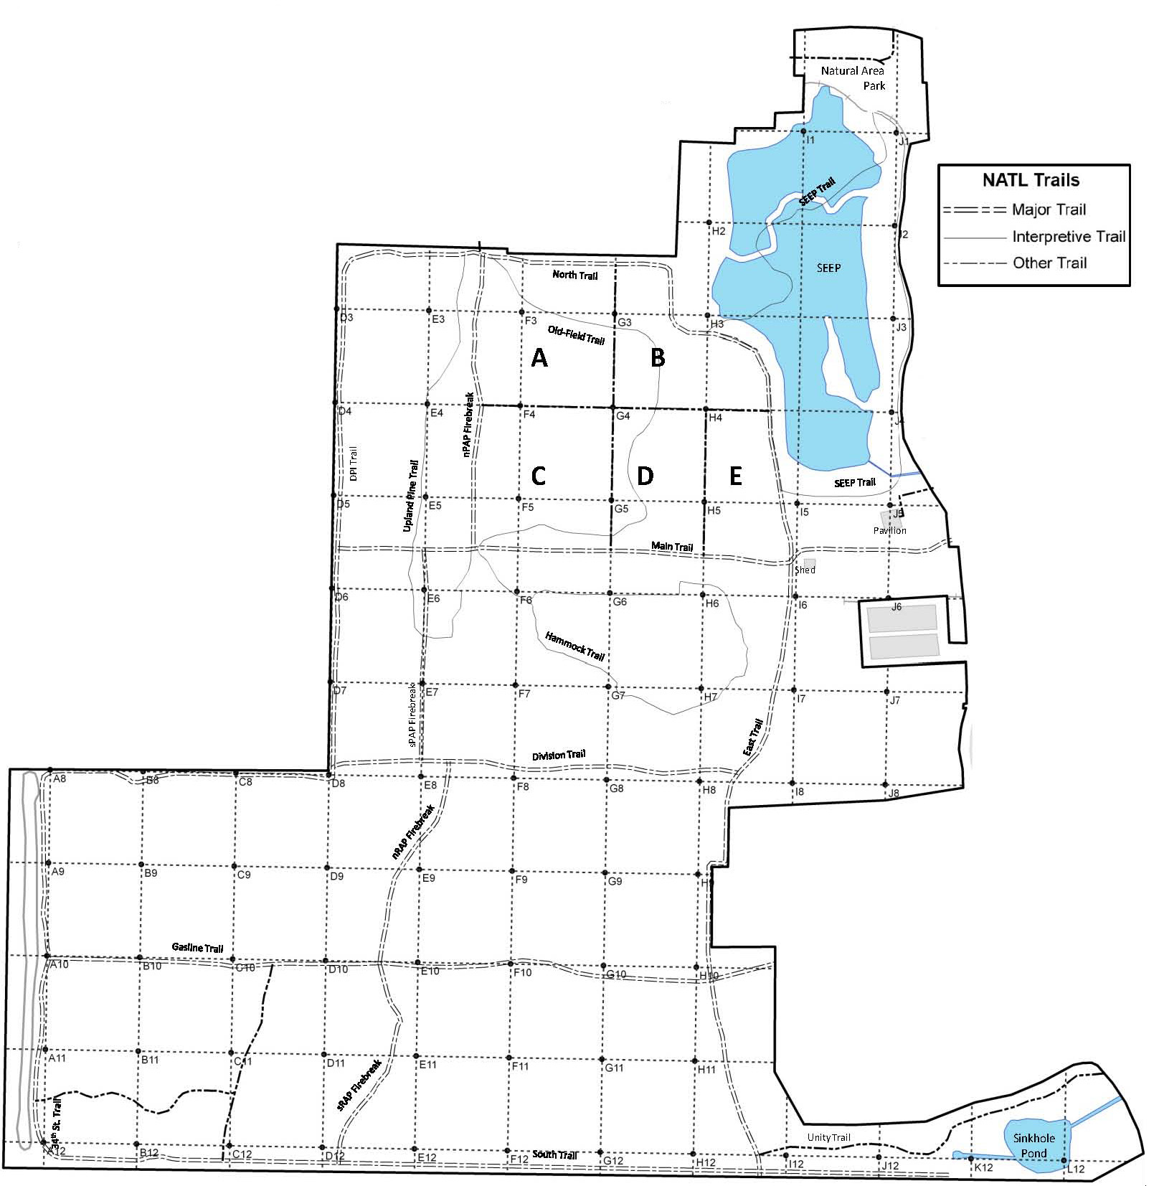
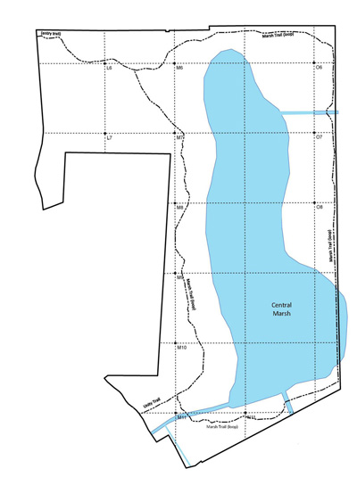
Johnsongrass (Sorghum halepense)
Potential threat for NATL: □ Major □ Moderate □ Minor □ Uncertain Current status in NATL: □ Eradicated □ Controlled □ Diminished □ Threatening
Current management: □ Routine monitoring □ Controlled when found by:
□ Manual removal □ Herbicide applied to: foliage stem or stump soil
Legend
Legacy site New active site
(prior to 2010) (2012)
NATL-west
NATL-east
□ No sites in NATL-east □ See larger map for details
Map created by Robert Guggenheim

