Slide 1
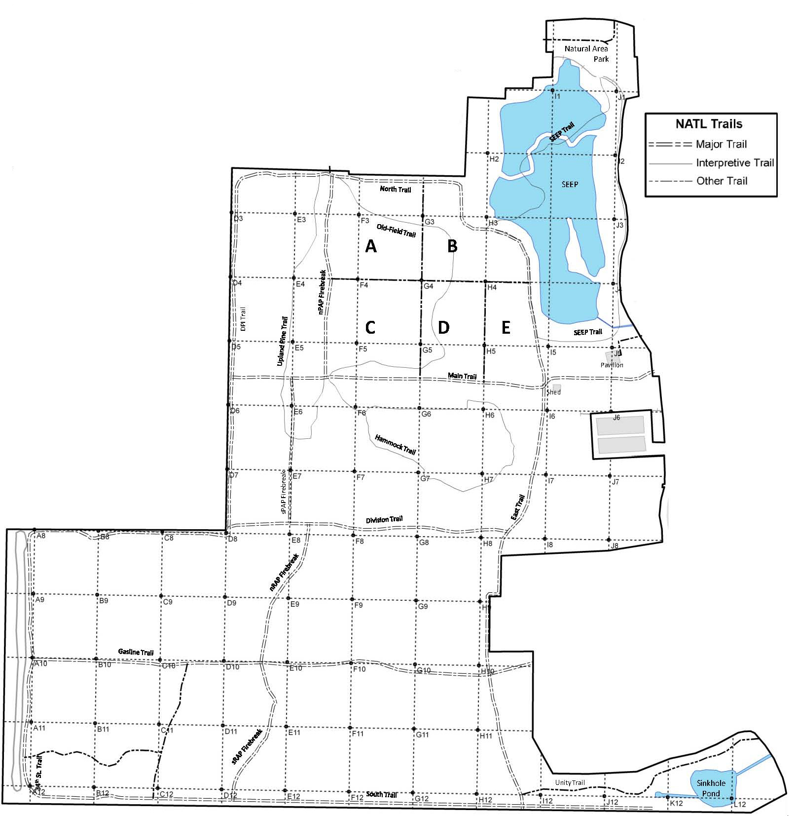
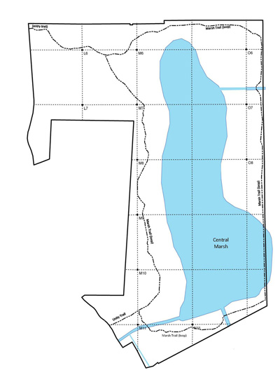
Chinese Tallowtree (Sapium sebiferum)
Potential threat for NATL: □ Major □ Moderate □ Minor □ Uncertain Current status in NATL: □ Eradicated □ Controlled □ Diminished □ Threatening
Current management: □ Routine monitoring □ Controlled when found by:
□ Manual removal □ Herbicide applied to: foliage stem or stump soil
Legend Legacy site Young trees abundant Mature trees removed 2011-12
NATL-west
NATL-east

