Slide 1
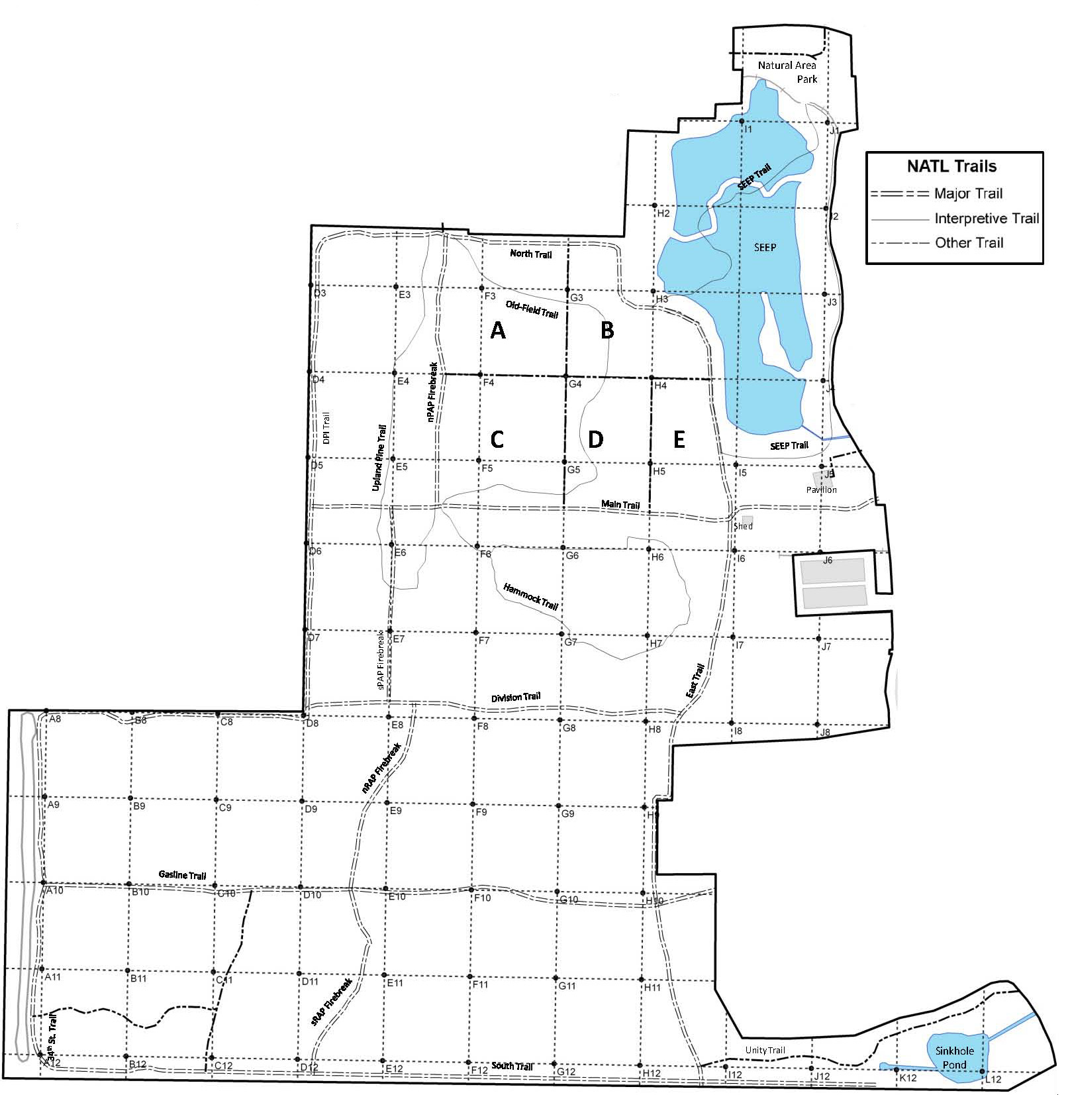
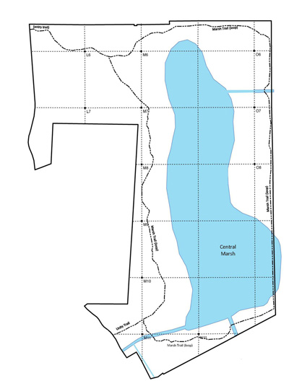
Cogan Grass (Imperata cylindrica)
Potential threat for NATL: □ Major □ Moderate □ Minor □ Uncertain Current status in NATL: □ Eradicated □ Controlled □ Diminished □ Threatening
Current management: □ Routine monitoring □ Controlled when found by:
□ Manual removal □ Herbicide applied to: foliage stem or stump soil
Legend Legacy site Active site Active site Maximum area of (2010-11) (2012) general infestation
NATL-west
NATL-east
□ No sites in NATL-east □ See larger map for details

