Slide 1
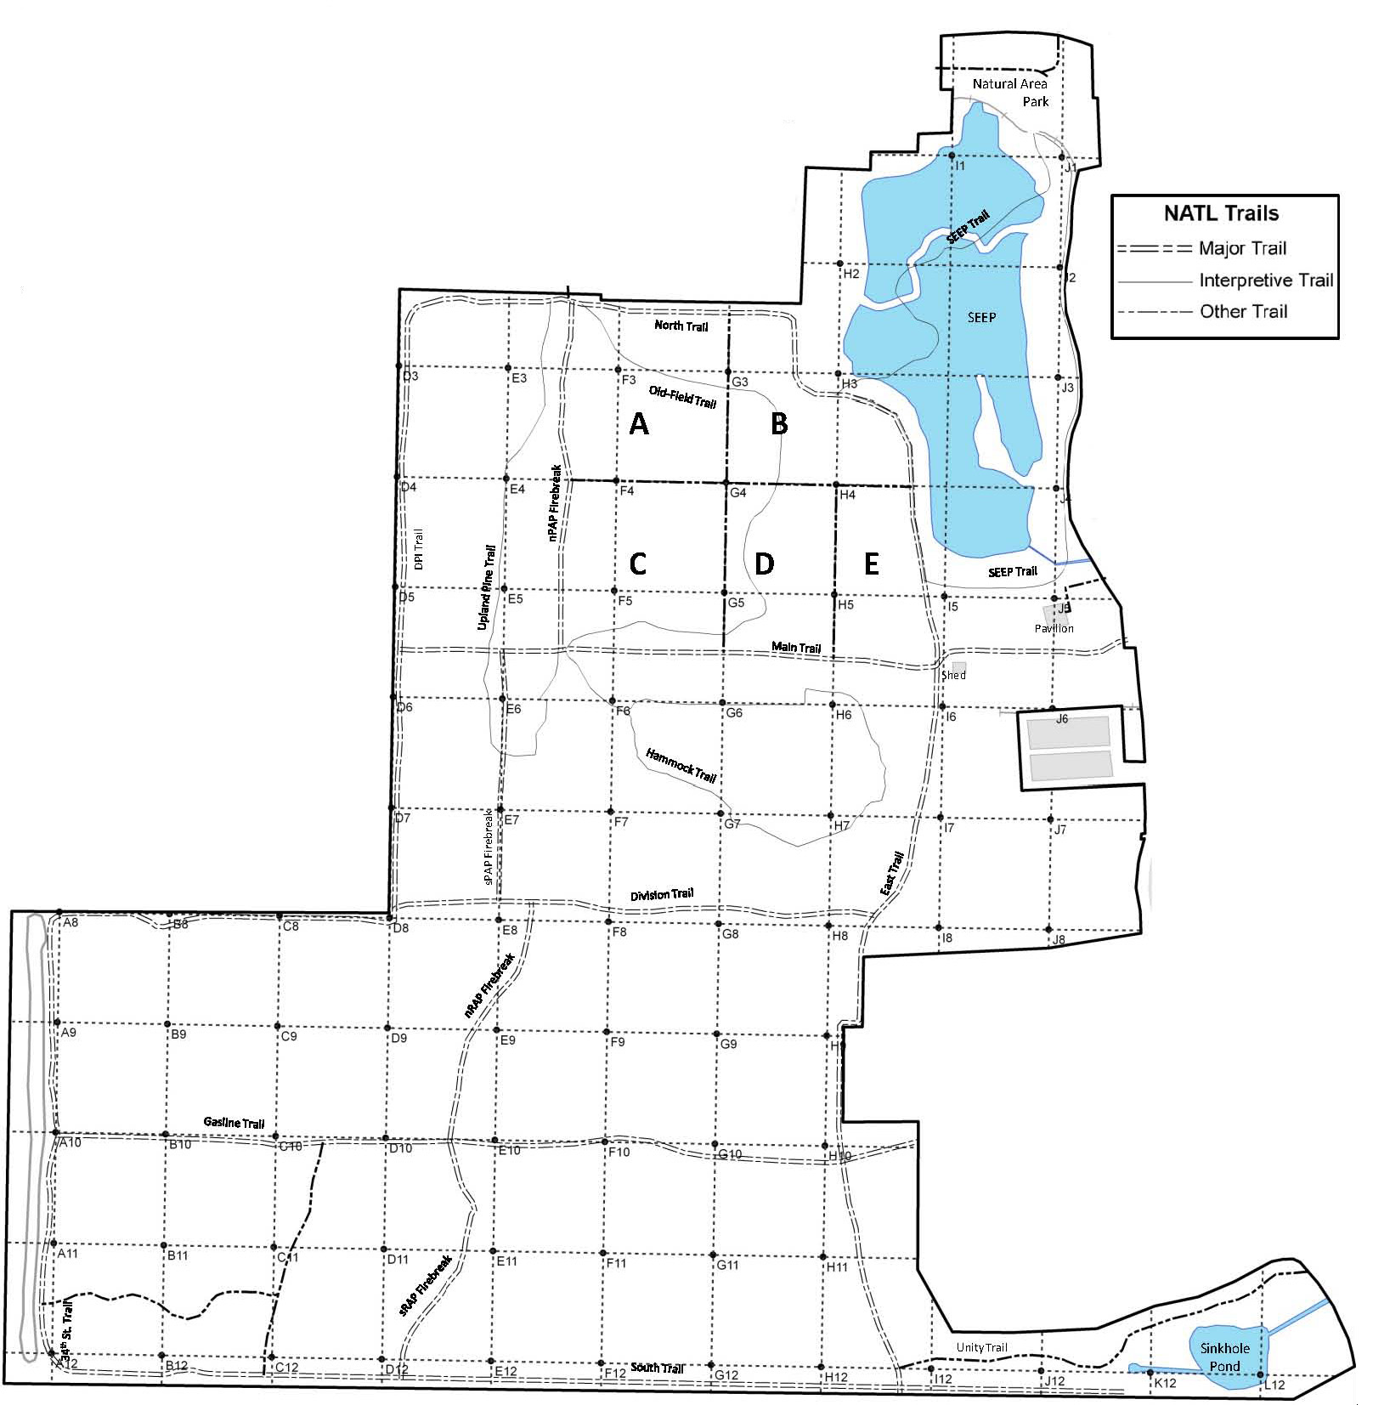
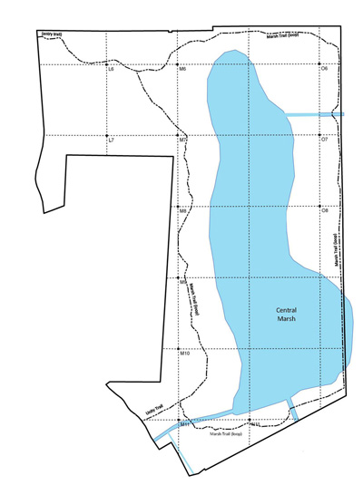
Coral Ardisia (Ardisia crenata)
Potential threat for NATL: □ Major □ Moderate □ Minor □ Uncertain Current status in NATL: □ Eradicated □ Controlled □ Diminished □ Threatening
Current management: □ Routine monitoring □ Controlled when found by:
□ Manual removal □ Herbicide applied to: foliage stem or stump soil
Legend Legacy block Active block (=1 mature plant in 2012) Extent of infestation
NATL-west
NATL-east

