Slide 1
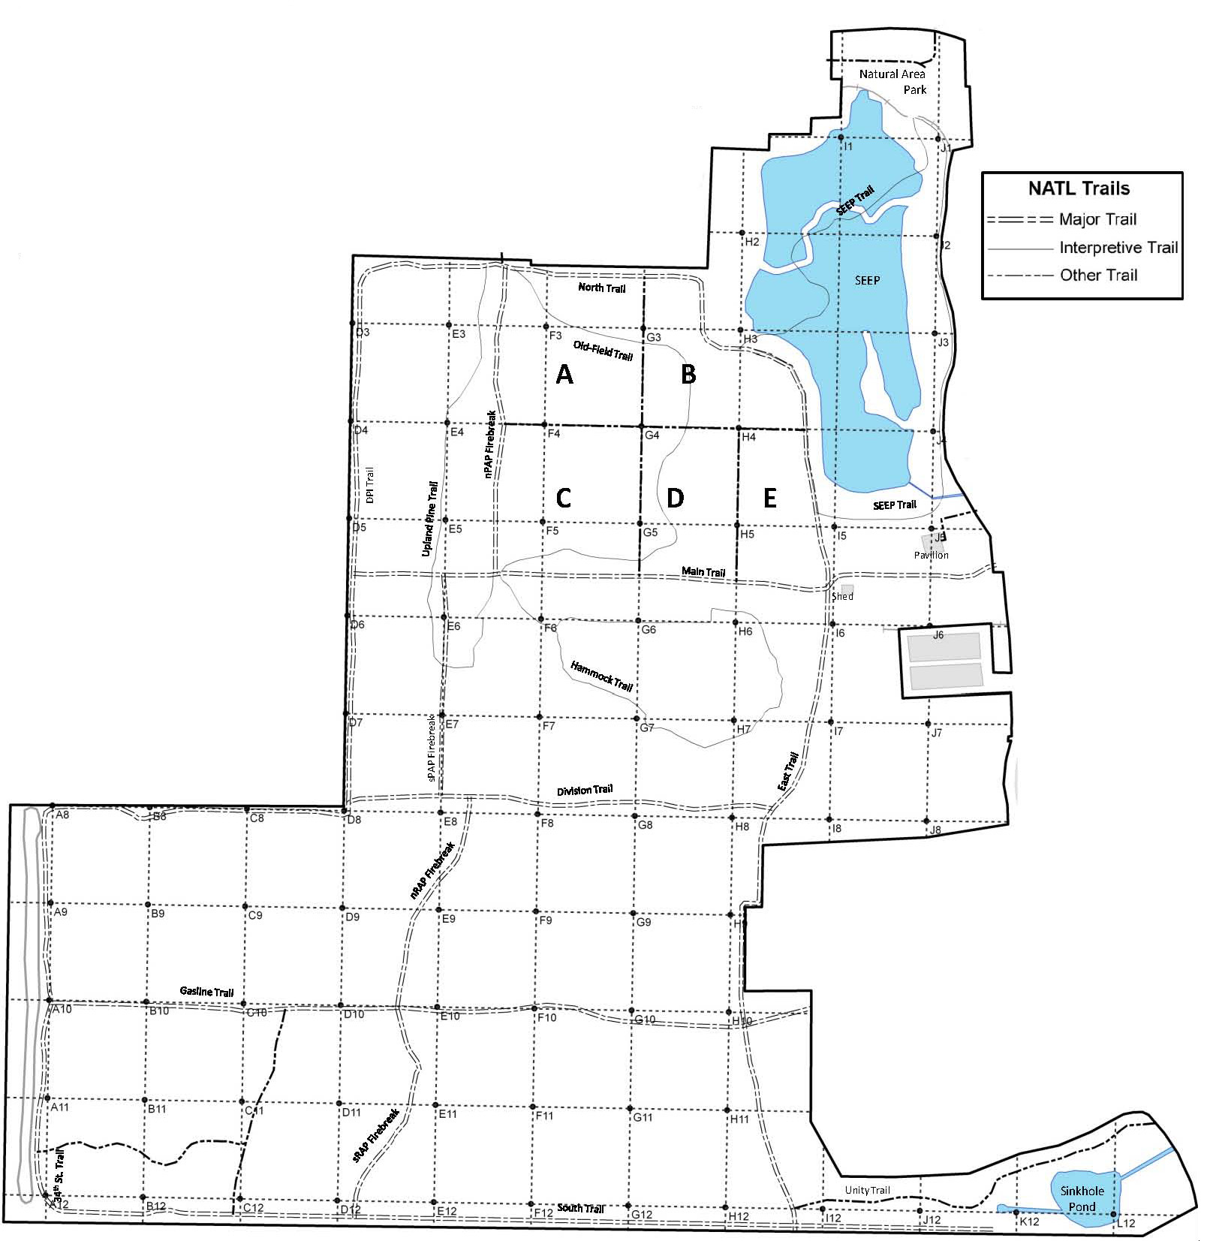
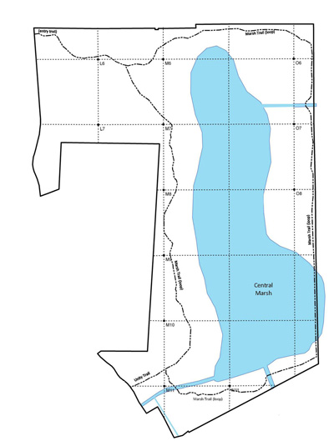
Johnsongrass (Sorghum halepense)
Potential threat for NATL: □ Major □ Moderate □ Minor □ Uncertain Current status in NATL: □ Eradicated □ Controlled □ Diminished □ Threatening
Current management: □ Routine monitoring □ Controlled when found by:
□ Manual removal □ Herbicide applied to: foliage stem or stump soil
Legend
New active site Extent of general infestation
(2012) (1994-2004)
NATL-west
NATL-east
□ No sites in NATL-east □ See larger map for details

