Slide 1
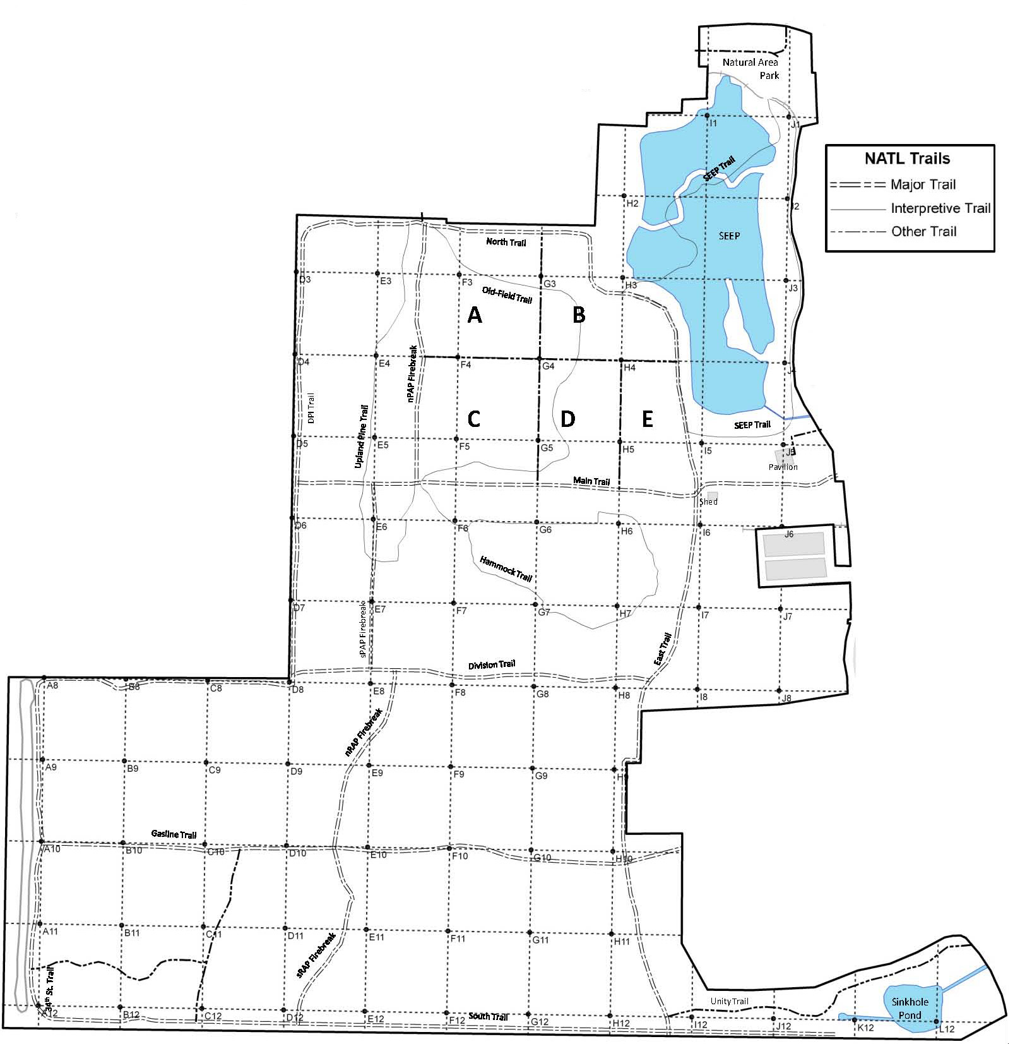
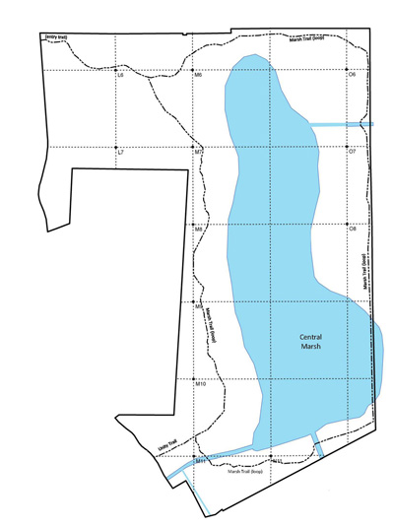
Mimosa (Albizia julibrissin)
Potential threat for NATL: □ Major □ Moderate □ Minor □ Uncertain Current status in NATL: □ Eradicated □ Controlled □ Diminished □ Threatening
Current management: □ Routine monitoring □ Controlled when found by:
□ Manual removal □ Herbicide applied to: foliage stem or stump soil
Legend Legacy block Young trees abundant Mature trees removed 2011-12
NATL-west
NATL-east
□ No sites in NATL-east □ See larger map for details

