Slide 1
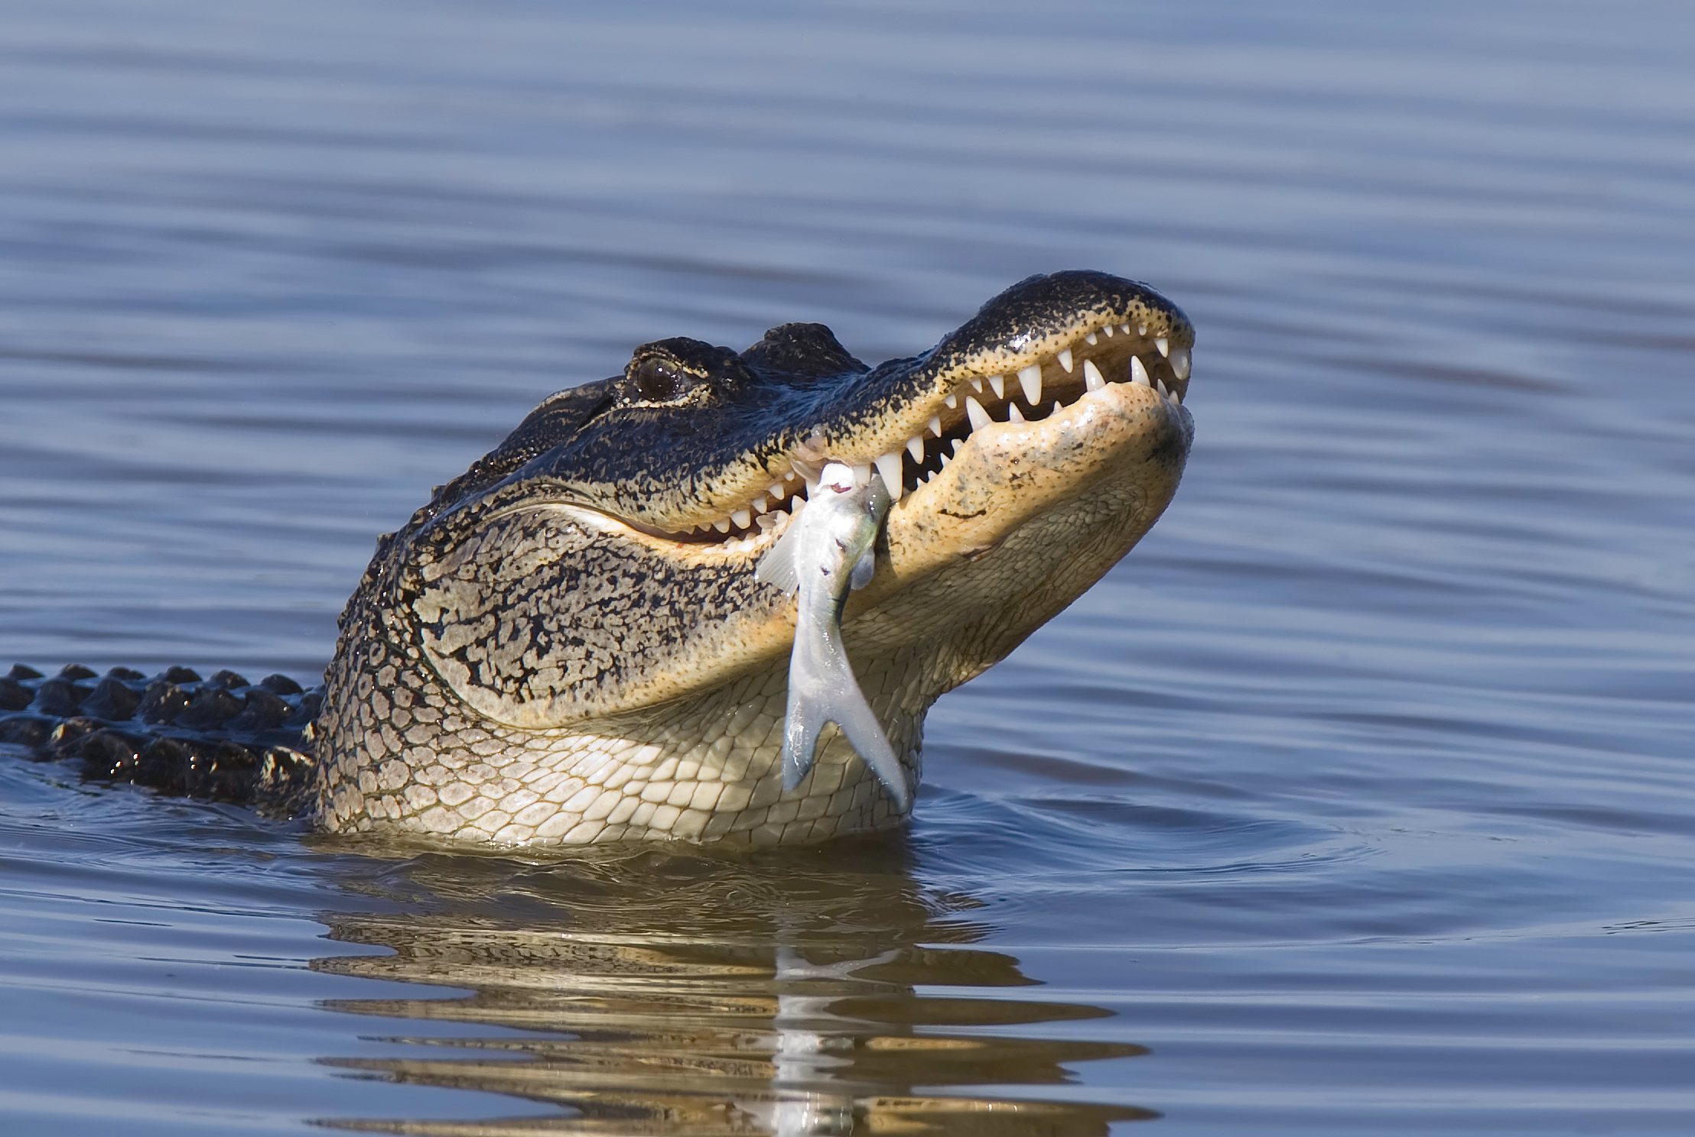
CAUTION!
ALLIGATOR NESTING AREA
Female alligators are very protective of their nest and young, and can be extremely aggressive towards intruders.
One or more alligators may be found in SEEP year-round, so visitors should stay on the boardwalk and designated trails. Alligator nesting generally occurs between June and July with eggs hatching about 2 months after laying. Female alligators have been known to stay with their young for several months after they hatch, making the period to be extra cautious last from May through October.
An alligator nested in SEEP in 2001, 2003, and 2009 (each year at a different location). If you see an alligator that appears to be guarding a nest, stay away! ( but please report its location to natl@ufl.edu ).

